Slide 1
UNIX Standardization and Implementations
Chapter 2 - Advanced Programming in the UNIX Environment
Notes:
Welcome to Chapter 2 of APUE. This presentation covers the evolution of UNIX standards, various implementations, and how to write portable code. We'll explore ISO C, POSIX, Single UNIX Specification, and examine limits and options that affect program portability.

Slide 2
Chapter Overview
Topics Covered:
• UNIX Standardization History
• ISO C Standard
• IEEE POSIX Standards
• Single UNIX Specification
• UNIX System Implementations
• Limits and Options
• Primitive System Data Types
Notes:
This chapter is crucial for understanding how to write portable UNIX applications. We'll examine the various standards that have evolved over the past decades and how they affect modern UNIX programming. Understanding these standards helps ensure your code works across different UNIX-like systems.

Slide 3
Why UNIX Standardization?
Historical Context:
• Proliferation of UNIX versions in the 1980s
• Different implementations had incompatible features
• Large users (e.g., U.S. government) demanded standardization
Benefits of Standardization:
• Application portability across systems
• Consistent programming interfaces
• Reduced development and maintenance costs
Notes:
During the 1980s, many different versions of UNIX emerged, each with unique features and incompatibilities. This fragmentation made it difficult to write portable applications. Large organizations, particularly the U.S. government, pushed for standardization to ensure software could run on different UNIX systems without modification.

Slide 4
ISO C Standard
Key Points:
• ANSI X3.159-1989 / ISO/IEC 9899:1990
• Defines C language syntax and semantics
• Includes standard library specification
• Updated in 1999 (C99) and 2011 (C11)
24 Standard Headers:
• <stdio.h>, <stdlib.h>, <string.h>, <math.h>, etc.
• All supported by modern UNIX systems
Notes:
The ISO C standard is fundamental to UNIX programming. It standardizes the C programming language and its library, ensuring consistent behavior across platforms. The 1999 update added features for numerical processing and introduced the 'restrict' keyword for optimization. All UNIX systems provide the ISO C library as a foundation for system programming.

Slide 5
IEEE POSIX Standards
POSIX = Portable Operating System Interface
Evolution:
• 1988: IEEE 1003.1-1988 (original)
• 1990: IEEE 1003.1-1990 (ISO/IEC 9945-1:1990)
• 1996: Added real-time extensions and pthreads
• 2001: Combined multiple standards
• 2008: POSIX.1-2008 (current version)
Key Feature: No distinction between system calls and library functions
Notes:
POSIX is a family of standards that define the interface between applications and the operating system. Unlike implementation-specific documentation, POSIX doesn't distinguish between system calls and library functions - all are simply called 'functions'. This abstraction allows different implementations while maintaining a consistent interface. POSIX.1-2008 is the current version we focus on.

Slide 6
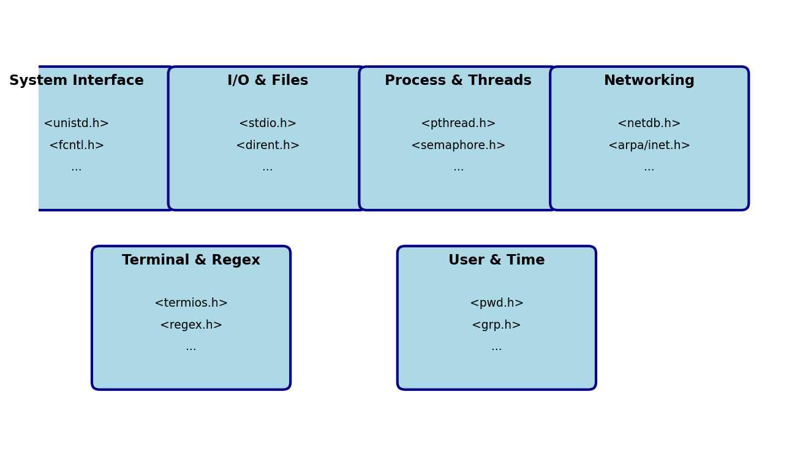
POSIX Required Headers
Notes:
POSIX defines numerous required headers organized by functionality. System interface headers provide core OS interactions, I/O headers handle file operations, process/thread headers manage concurrency, networking headers enable network programming, and utility headers provide terminal control, pattern matching, and user/time management. Understanding which headers to include is crucial for portable programming.

Slide 7
Single UNIX Specification (SUS)
Key Points:
• Superset of POSIX.1
• Defines additional interfaces beyond POSIX
• XSI (X/Open System Interfaces) conformance required for UNIX branding
Versions:
• 1994: SUSv1 (Spec 1170)
• 1997: SUSv2
• 2001: SUSv3 (aligned with POSIX.1-2001)
• 2010: SUSv4 (aligned with POSIX.1-2008)
Notes:
The Single UNIX Specification extends POSIX.1 with additional interfaces. Only systems that implement the XSI option and pass conformance tests can legally use the UNIX trademark. This specification grew from industry efforts to improve application portability beyond basic POSIX compliance. SUSv4 is the current version, aligned with POSIX.1-2008.

Slide 8
Major UNIX Implementations
Systems Covered in This Book:
• FreeBSD 8.0
• Linux 3.2.0 (Ubuntu 12.04)
• Mac OS X 10.6.8
• Solaris 10
Other UNIX Systems: AIX, HP-UX, IRIX, UnixWare
Notes:
We focus on four implementations that represent different UNIX lineages. FreeBSD continues the BSD tradition, Linux provides a free UNIX-like environment, Mac OS X combines Mach kernel with FreeBSD userland, and Solaris represents the System V lineage. Only Mac OS X and Solaris are certified UNIX systems, but all four provide similar programming environments.

Slide 9
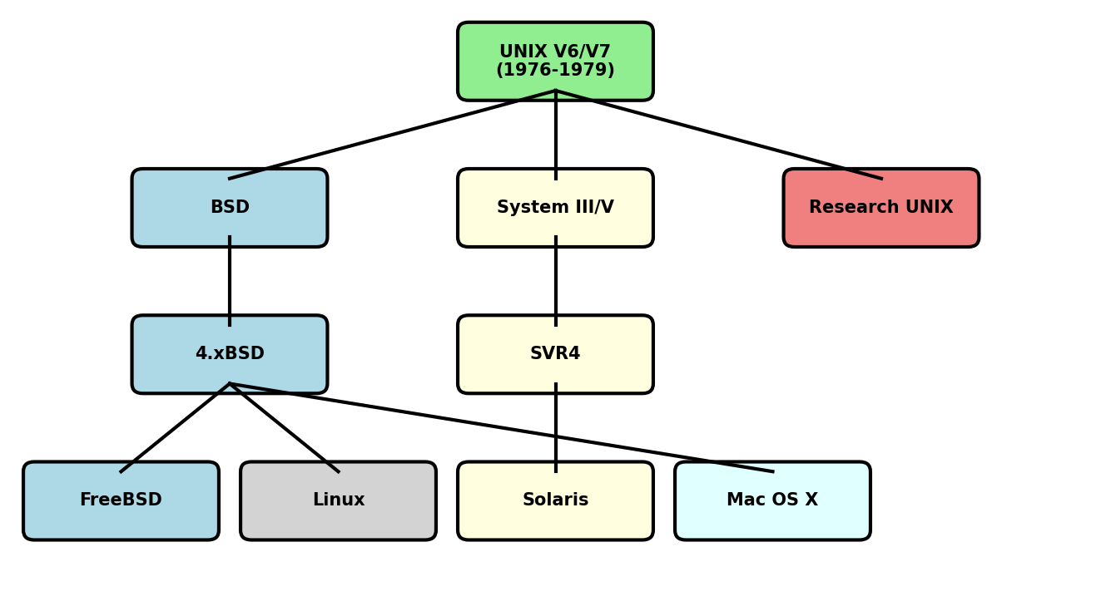
UNIX System Evolution
Notes:
The UNIX family tree shows three main branches from the original Version 6 and 7: BSD (Berkeley), System V (AT&T commercial), and Research UNIX. Modern systems derive from these branches - FreeBSD from 4.4BSD, Solaris from SVR4, Mac OS X combines BSD and Mach, while Linux was created independently but follows UNIX design principles.

Slide 10
Implementation Limits
Types of Limits:
1. Compile-time limits
2. Runtime limits not associated with files
3. Runtime limits associated with files/directories
Examples:
• PATH_MAX - Maximum path length
• OPEN_MAX - Maximum open files
• NAME_MAX - Maximum filename length
Notes:
Understanding limits is crucial for writing portable code. Some limits are known at compile time (like integer sizes), others must be queried at runtime. File-related limits may vary by filesystem. The three conf functions allow programs to adapt to system-specific limits. Always check for indeterminate values (-1 with errno unchanged) which indicate no practical limit.

Slide 11
Querying System Limits
Function Prototypes:
long sysconf(int name);
long pathconf(const char *pathname, int name);
long fpathconf(int fd, int name);
Return Values:
• ≥ 0: The limit value
• -1 with errno = EINVAL: Invalid name
• -1 with errno unchanged: Indeterminate limit
Notes:
These three functions are essential for determining system limits at runtime. sysconf queries system-wide limits, pathconf works with pathnames, and fpathconf uses file descriptors. The distinction between error (-1 with errno set) and indeterminate limit (-1 with errno unchanged) is critical. Indeterminate doesn't mean infinite - it means the system doesn't impose a fixed limit.

Slide 12
Dealing with Indeterminate Limits
Problem: What if a limit returns -1 (indeterminate)?
Example Solutions:
PATH_MAX:
Allocate initial buffer
If operation fails with ERANGE, increase size
Retry until success
OPEN_MAX:
Use a reasonable guess (e.g., 256)
Or use getrlimit() if available
Notes:
Indeterminate limits require creative solutions. For PATH_MAX, dynamic allocation with retry logic works well. For OPEN_MAX, using a reasonable guess or the getrlimit function (if available) provides workable solutions. The key is to write defensive code that doesn't assume specific limit values and can adapt to different systems.

Slide 13
Feature Test Macros
Purpose: Control which features are visible in headers
Common Macros:
_POSIX_C_SOURCE=200809L
• Enables POSIX.1-2008 features
_XOPEN_SOURCE=700
• Enables XSI features (SUSv4)
Usage:
cc -D_POSIX_C_SOURCE=200809L file.c
Notes:
Feature test macros allow fine control over which standards-based features are exposed by system headers. This prevents namespace pollution and ensures your code only uses features from specific standards. Define these before including any headers, typically via compiler flags. This is crucial for writing strictly conforming applications.

Slide 14
Primitive System Data Types
Why Use typedef'd Types?
• Hide implementation details
• Enable portability across systems
• Most end in _t
Common Types:
• pid_t - Process IDs
• size_t - Object sizes (unsigned)
• ssize_t - Byte counts (signed)
• time_t - Time values
• uid_t, gid_t - User and group IDs
Notes:
Primitive system data types abstract implementation details. For example, pid_t might be a short on one system and an int on another. By using these typedef'd types instead of raw C types, your code remains portable. Always use the appropriate type - for instance, use ssize_t for read/write return values, not int.

Slide 15
Example: Querying System Limits
#include <unistd.h>
#include <limits.h>
#include <stdio.h>
int main() {
long val;
/* Query maximum number of open files */
if ((val = sysconf(_SC_OPEN_MAX)) < 0) {
if (errno == 0)
printf("OPEN_MAX is indeterminate\n");
else
perror("sysconf error");
} else {
printf("OPEN_MAX = %ld\n", val);
}
/* Query maximum path length */
if ((val = pathconf("/", _PC_PATH_MAX)) < 0) {
if (errno == 0)
printf("PATH_MAX is indeterminate\n");
else
perror("pathconf error");
} else {
printf("PATH_MAX = %ld\n", val);
}
return 0;
}
Notes:
This example demonstrates proper use of sysconf and pathconf. Note the careful error handling - we distinguish between actual errors (errno set) and indeterminate values (errno unchanged). When querying PATH_MAX with pathconf, we use '/' as the path to get the system-wide maximum. In practice, you might query specific directories as limits can vary by filesystem.

Slide 16
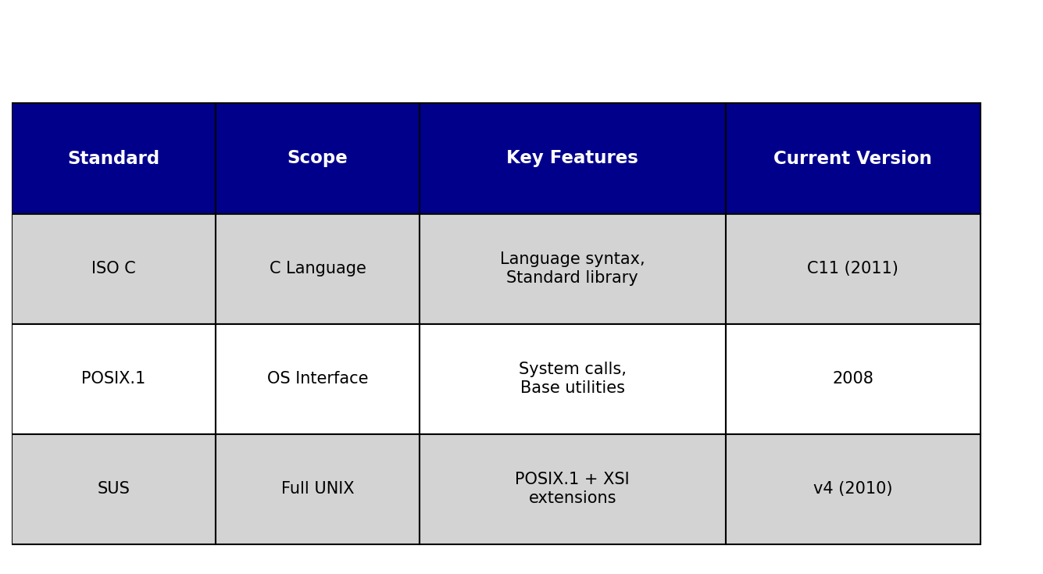
Standards Comparison
Notes:
This comparison shows how the standards build on each other. ISO C provides the foundation with the C language and library. POSIX.1 adds operating system interfaces but remains abstract enough for non-UNIX systems. The Single UNIX Specification adds XSI extensions and defines what it means to be a UNIX system. Understanding these relationships helps in writing portable code.

Slide 17
Key Takeaways
1. Standards enable portability
• Write to standards, not implementations
2. Know your target standards
• POSIX.1 for maximum portability
• XSI for UNIX-specific features
3. Handle limits properly
• Check compile-time and runtime limits
• Deal with indeterminate values
4. Use proper data types
• Use system typedefs (pid_t, size_t, etc.)
Notes:
These key points summarize the essential knowledge for writing portable UNIX applications. Always target standards rather than specific implementations. Understand which features belong to which standards. Properly query and handle system limits, especially indeterminate ones. Use the abstract data types provided by the system headers. Following these principles ensures your code works across different UNIX and UNIX-like systems.

Slide 18
Questions & Additional Resources
Resources:
• POSIX.1-2008 Standard
• Single UNIX Specification v4
• Stevens & Rago: APUE 3rd Edition
• System man pages (sections 2 & 3)
Online:
• opengroup.org/austin - Austin Group
• pubs.opengroup.org - Standards documents
Notes:
For deeper understanding, consult the actual standards documents available from The Open Group. The APUE book provides excellent practical examples and explanations. System man pages document implementation-specific details. The Austin Group maintains the POSIX standards and provides clarifications. Regular consultation of these resources helps in writing robust, portable UNIX applications.

